Slide 1
Calypso – OFF2013 Snapshot on Model Development
Szilvia Zaray
Project Manager, HNFR
Hungarian-Croatian Working Group on Tourism, 18/06/2013
Notes:
The Calypso program is ….

Slide 2
Overall objectives
OFF2013 2
Facilitating low-season transnational exchanges between Hungary and Poland
Social: inclusion, integration, health preservation
Economic: fighting seasonality – supporting active employment – generating economic growth and regional development
Notes:
The overall objective of OFF2013 is to facilitate low-season transnational exchanges of seniors and families facing difficult circumstances in Hungary and Poland. The partners of the consortium being dedicated to “Tourism for all” and “Europe, the world’s No. 1 tourist destination” aim to create opportunities for the above 2 CALYPSO target groups to spend their holiday abroad at an affordable price. Besides the social aspect of inclusion, integration and health preservation, the project is also to generate economic growth by developing exchange schemes, competitive solutions and travel packages designed especially to the needs of the target groups, bringing them to sites that have low number of visitors during off season, and by that fighting with the problem of seasonality, helping seasonal employees keeping their jobs for more months out of the year, supporting active employment. Another goal of the project is – by boosting the demand and making the SMEs aware of the economic potentials in social tourism – to indirectly contribute to the improvement of destinations, to exploit local endowments and to live with the opportunity to promote local products/services. Behind all these goals lies the undermining desire to foster European culture and nourish European identity, to promote a fuller European understanding.

Slide 3
Partners
OFF2013 3
HNFR (lead partner),
Cracow University of Economics (UEK),
Ministry for National Economy of Hungary,
Hungarian Association of Hotels and Restaurants,
National Federation of Rural and Agrotourism
Notes:
Lead partner/coordinator: MNUA - Hungarian National Foundation for Recreation (Hungary)
Partners: Cracow University of Economics (Poland), Ministry for National Economy (Hungary), Hungarian Association of Hotels and Restaurants (Hungary), National Federation of Rural and Agrotourism (Hungary)

Slide 4
Target groups
OFF2013 4
Seniors: 50+ active seniors,
pensioners
Families: large families,
single parent families,
families with small children
Notes:
It is important to make subgroups, to differentiate within one target group.
Involvement of civic organizations representing the chosen target groups. (advises in the planning phase, testing at the end of the development phase)

Slide 5
Tools
OFF2013 5
Bringing public and private stakeholders together to join in a common project
Networking: sharing ideas
Research and surveys: examining the social tourism supply and demand side
Business model development
Notes:
- to bring the public and the private stakeholders together to join in a common work, all sides contributing with their own experiences and competences;
- to network, to provide opportunities for all stakeholders not only to share ideas at national and transnational level by organizing meetings and workshops, but also to develop together transnational cooperation processes, to share good practices transnational, to examine the social tourism supply and demand transnational, to make all stakeholders get connected, to identify the exact target (sub)groups’ constraints, the exchange periods, mechanisms, incentives to ensure participation, etc. The workshops should provide opportunity to get down to very practical questions, to simulate the needs and interests of all sides, developing a business model;
- to explore the connection possibilities to the Calypso web platform, an information sharing tool, that is a key to sustainability;

Slide 6
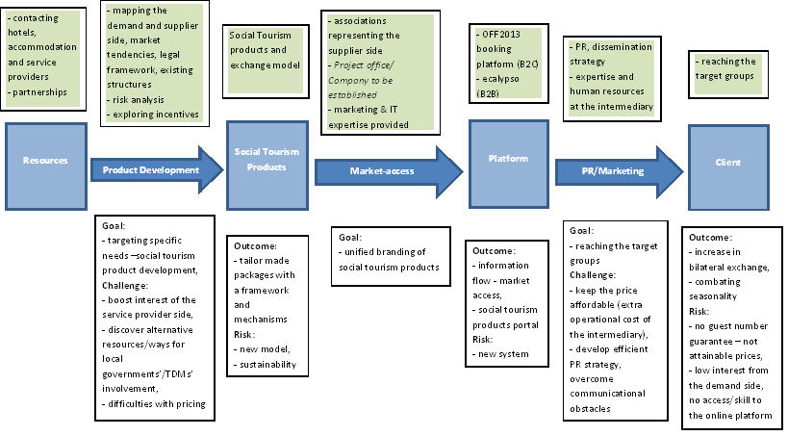
Model Development
OFF2013 6
Notes:
- to explore the connection possibilities to the Calypso web platform, an information sharing tool, that is a key to sustainability;
- to improve the knowledge base by the preparation of discussion/argument papers, feasibility study, LogFrame analysis;
- to present a viable social tourism model that in the years to come allows the exchange of seniors and families between Hungary and Poland.

Slide 7
Snapshot
OFF2013 7
Contacted potential stakeholders
Project webpage
Demand and supply side mapped
More information from the demand side is necessary
SWOT analysis of preliminary model
Started to explore potential incentives and ways of local contribution
More consultation needed
Notes:
- to explore the connection possibilities to the Calypso web platform, an information sharing tool, that is a key to sustainability;
- to improve the knowledge base by the preparation of discussion/argument papers, feasibility study, LogFrame analysis;
- to present a viable social tourism model that in the years to come allows the exchange of seniors and families between Hungary and Poland.

Slide 8
Snapshot
OFF2013 8
Started to explore platform solutions
OFF2013’s own platform, ecalypso.eu
Platform - IT development
Sustainable organizational framework
Feasibility study, surveys
PR strategy
Dissemination
Notes:
- to explore the connection possibilities to the Calypso web platform, an information sharing tool, that is a key to sustainability;
- to improve the knowledge base by the preparation of discussion/argument papers, feasibility study, LogFrame analysis;
- to present a viable social tourism model that in the years to come allows the exchange of seniors and families between Hungary and Poland.

Slide 9
OFF2013 9
Thank you for your attention
Szilvia Zaray
Project Manager
HNFR - International Relations
Email: foundation@mnua.hu
Tel: +36 -1- 505-8493

